Slide 1


embedded systems
Workshop Level 1 - Be Ready for

Slide 2


WHO AM I ?
My Name: Ahmed Ibrahim Asl
Embedded software engineer
Head of embedded systems at GDSC delta university
communication and telecom engineering student at Delta university

Slide 3


what is embedded ?

Slide 4

Road Map
WEEK 1
WEEK 2
WEEK 3
Introduction
Logic
C
WEEK 4
WEEK 5
WEEK 6
Arduino
Computer architecture
Pointers

Slide 5



TYPING ⚠

Slide 6



CONTENTS
1
what is meaning of Programming ?
2
Difference between Programming and coding ?
3
Programming Language? / (High Level - low level)
4
Difference between (IDE - code editor- text editor)
5
Text Editor - Code Editor - IDE
6
Compiler - interpreter - Editor
7
Compilation Process
8
CMD-Basics

Slide 7



What is a Programming ?
written instructions given to computer to perform an action
these instructions: has to be very specific because computers are not smart as they seems !

Slide 8



CODING
PROGRAMMING
INVOLVES FOCUSING ON DETAILS OF IMPLEMENTING A SOLUTION AND WRITE THE SPECIFIC COMMANDS NECESSARY TO ACHIEVE A PARTICULAR TASK
A PROCESS THAT INVOLVE
DEVELOPING SOFTWARE OR APPLICATION
IT'S NOT ONLY ACT OF WRITING CODE (CODING)
BUT ALSO TASKS LIKE ANALYZING PROBLEMS,
DESIGN SOLUTIONS FOR THESE PROBLEMS

Slide 9


How do we write these instructions ?

Slide 10

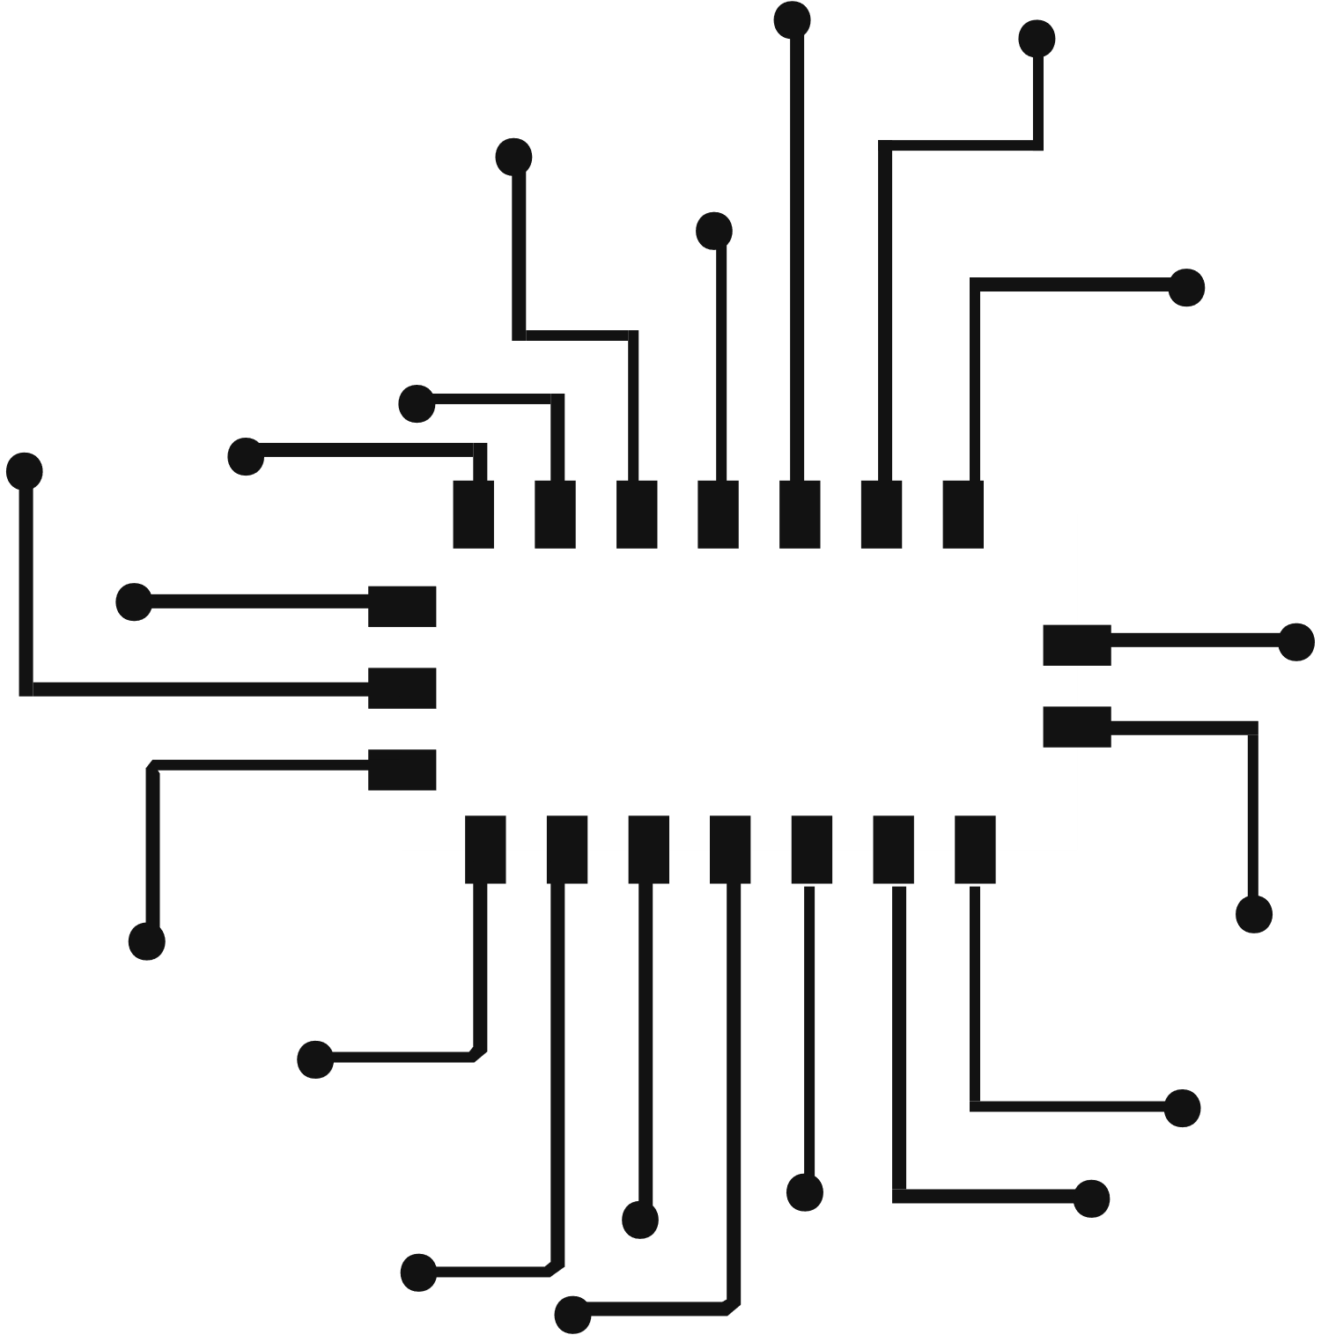
Computer language
Computers doesn't speak our language computer speaks 0s and 1s (this will be covered in logic part of workshop)
Problem we have now is 0s 1s are so hard for us to use to write fully functional programmers, what do you think we do ?
14

Slide 11

PROGRAMMING LANGUAGES
Language used to write instructions to computer much easier than using 0s and 1s
So if we want to learn Programming we have to go for all programming languages right ?
NO, Programming languages is like Tools some of them can be used in multiple of things General Purpose Tool
and some can only be used in one specific area Specific Purpose Tool

Slide 12


High level
Low Level
similar to English, needs translator to be executed like Example: python (they are General Purpose can be used in multiple of areas: Ai, automation, .....), C (Embedded systems ).
similar to Machine Language zeros and one's. doesn't require a translator to be executed Examples: assembly

Slide 13




where do we write these instructions ?

Slide 14
Text editor
Code eidtor
IDE
IDE (Integrated Development Environment): software package that combines a code editor with multiple of development tools. plus I can offer paid features to further enhance the programming experience."
A simple, lightweight software tool that allows you to create and edit plain text files providing minimalistic features like typing, deleting, saving and opening files. used for general text editing tasks and can be used for writing code in various programming languages with a lack of features.
software tools designed to help programmers by offering advance features like syntax highlighting, code execution and some of them offer terminal access, highly customizable with extensible plugins.

Slide 15





Visual studio
visual studio code

Slide 16





IDE Team
Editor
Compiler
Interpreter

Slide 17
I am your the mothers for all programmer, I can provide a space for Programmers to experiment there ideas in safe space, sadly I can just protect them from making syntax errors. Programmers feels safe with since I known almost all programming languages.
Editor

Slide 18
Think of me as detective who take your project and analyze it piece by piece slowly to ensure everything is right then I translate it into machine code and give you binary file to run your program so in next time you wouldn't need to repeat translation process again you would just run the binary file
Compiler

Slide 19
I am fast, I don't have time, me as well capable of translating the programming languages into machine code, unlike compiler I will run your instructions line by line while execution if you have an error it will be detected during the execution
Interpreter

Slide 20
so Now what programming Language are we going for ?

Slide 21



WHY C ?!
C is considered to be closed to hardware than C++, since This is because C does not have as many features as C++ like object-oriented programming. These layers add features of abstraction between the programmer and the hardware which make it more difficult to control the hardware directly, C++ would be better choice for applications like GUI application requires higher level of abstraction

Slide 22



OOP ?!
oop stands for "Object-Oriented Programming", supported variety of programming languages, the idea is to teach computer how to model real objects like people or game characters allowing developers to write code in more organized and maintainable way

Slide 23
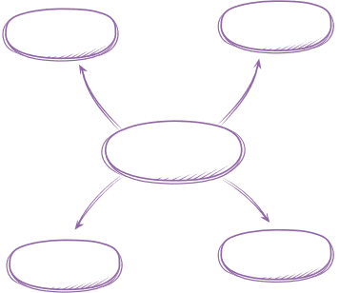




Compilation Process
All Project Files
Preprocessor
compiler
main.i
functions.i
main.asm
functions.asm

Slide 24
Compilation Process
Assembler
Linker
file.exe
main.o
function.o

Slide 25
CMD BASICS
Relative path - absolute path / create a workplace folder
1
2
open the workspace
3
experiment with making folders and view them
4
create a C file & open it
5
run it
6
automate this process 🏃‍♂️🏃‍♂️🏃‍♂️

